Slide 1
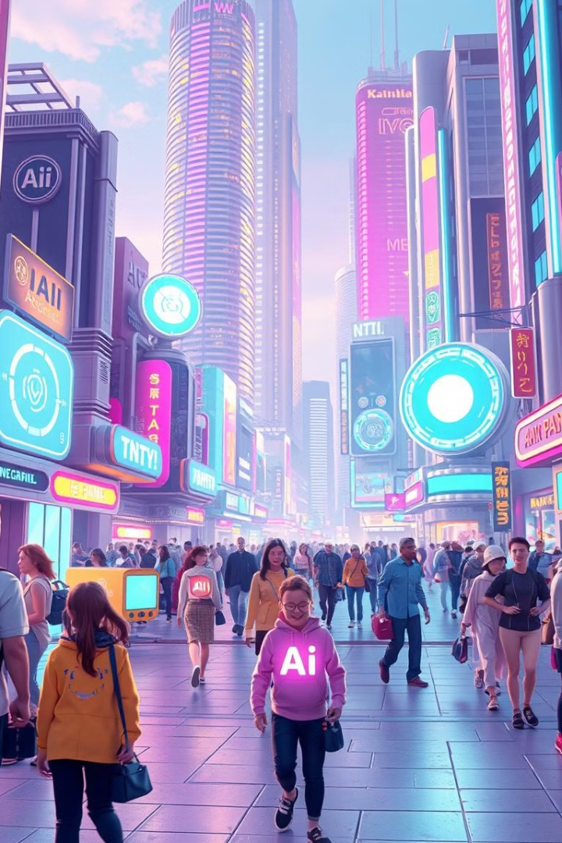
Exploring the World of AI and ML
Welcome to this exploration of AI and ML! Join us as we delve into the transformative power of these technologies, exploring their fundamental concepts, diverse applications, and exciting future possibilities.
By Daya Ram(23075A6713)

Slide 2
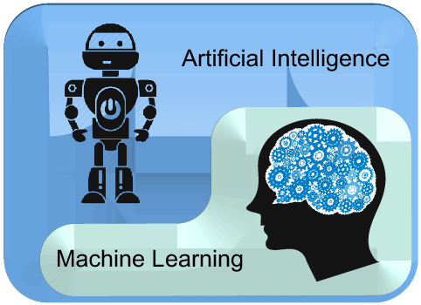
Artificial intelligence (AI) vs. machine learning (ML)
You might hear people use artificial intelligence (AI) and machine learning (ML) interchangeably, especially when discussing big data, predictive analytics, and other digital transformation topics.
The confusion is understandable as artificial intelligence and machine learning are closely related. However, these trending technologies differ in several ways, including scope, applications, and more.
Increasingly AI and ML Products have proliferated as businesses use them to process and analyze immense volumes of data, drive better decision-making, generate recommendations and insights in real time, and create accurate forecasts and predictions.
So, what exactly is the difference when it comes to ML vs. AI, how are ML and AI connected, and what do these terms mean in practice for organizations today?

Slide 3
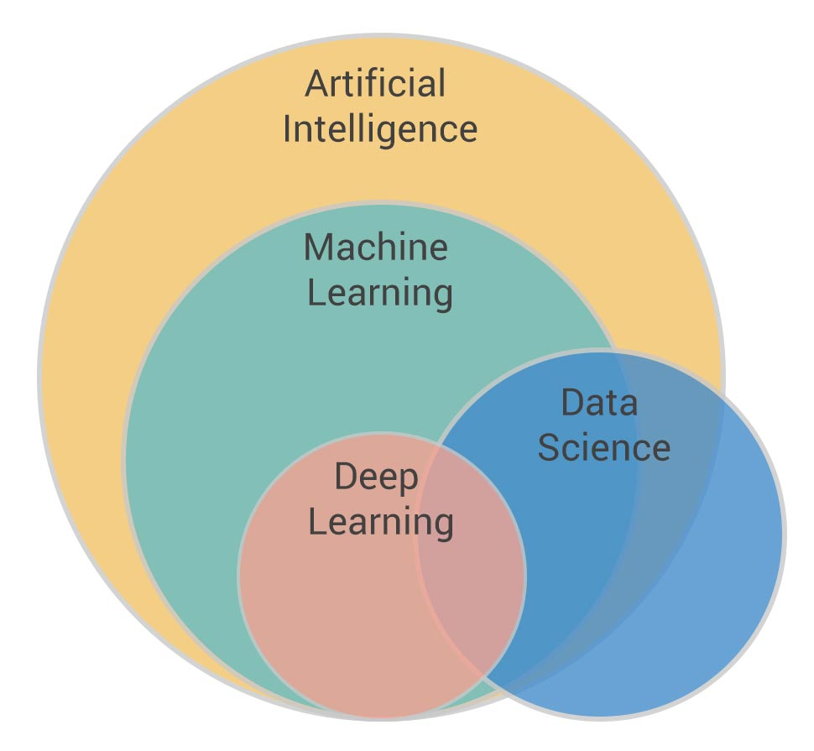
What is artificial intelligence?
Artificial intelligence is a broad field, which refers to the use of technologies to build machines and computers that have the ability to mimic cognitive functions associated with human intelligence, such as being able to see, understand, and respond to spoken or written language, analyze data, make recommendations, and more.
Although Artificial intelligence is often thought of as a system in itself, it is a set of technologies implemented in a system to enable it to reason, learn, and act to solve a complex problem.
What is machine learning?
Machine learning is a subset of artificial intelligence that automatically enables a machine or system to learn and improve from experience. Instead of explicit programming, machine learning uses algorithms to analyze large amounts of data, learn from the insights, and then make informed decisions.
Machine learning algorithms improve performance over time as they are trained—exposed to more data. Machine learning models are the output, or what the program learns from running an algorithm on training data. The more data used, the better the model will get.

Slide 4

The Rise of AI and ML
1
2
3
Early Concepts (1950s)
The AI Winter (1970s-1980s)
Modern Advancements (1990s-Present)
The foundation of AI and ML was laid with the development of key concepts, like the Turing Test, and early machine learning algorithms.
Progress slowed due to limitations in computing power and a lack of real-world applications.
Significant advancements in computing power, data availability, and algorithms led to a resurgence of AI and ML, driving widespread adoption across industries.

Slide 5
Machine Learning Algorithms and Techniques
Supervised Learning
Unsupervised Learning
Supervised learning involves training models on labeled data, where both the inputs and desired outputs are provided. Examples include linear regression, logistic regression, and support vector machines.
Unsupervised learning deals with unlabeled data, aiming to discover patterns and insights without explicit guidance. Techniques include clustering, dimensionality reduction, and association rule mining.
Reinforcement Learning
Deep Learning
Reinforcement learning involves training agents to interact with an environment and learn through trial and error. This is commonly used in robotics, game playing, and control systems.
Deep learning utilizes artificial neural networks with multiple layers to extract complex patterns from data. It has achieved remarkable success in areas like image recognition, natural language processing, and speech synthesis.

Slide 6
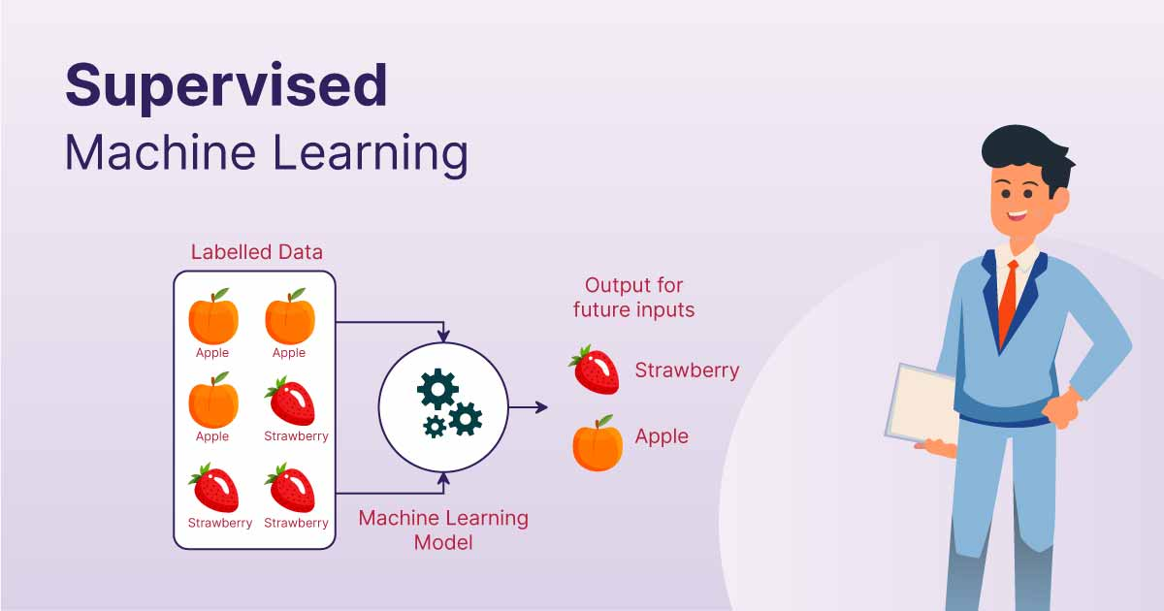
SUPERVISED MACHINE LEARNING

Slide 7
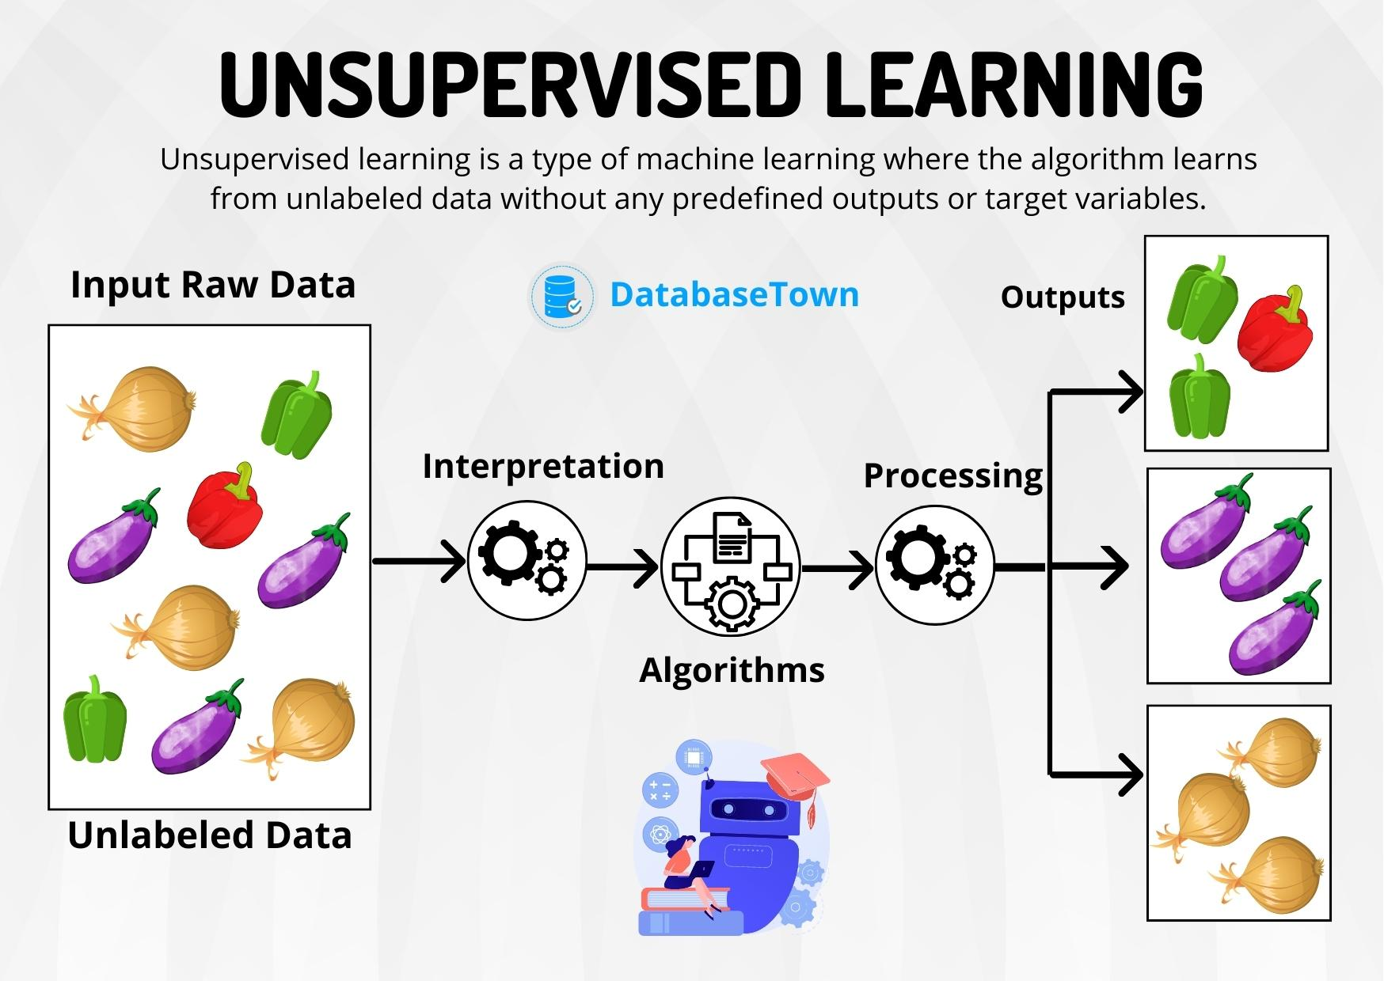
UNSUPERVISED MACHINE LEARNING

Slide 8
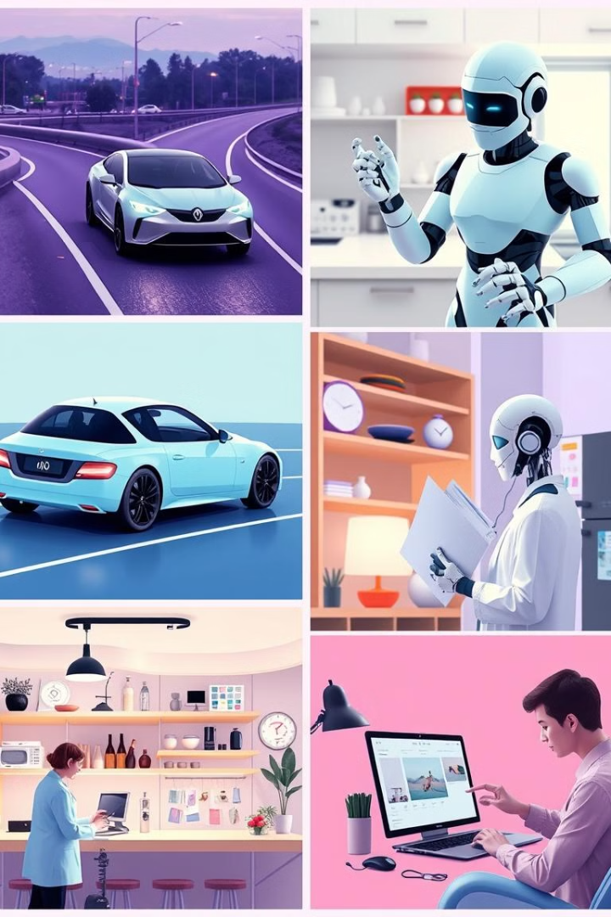




Applications of AI and ML
Autonomous Vehicles
Healthcare and Medicine
AI-powered self-driving cars enhance safety, efficiency, and convenience, revolutionizing transportation.
ML algorithms assist in disease diagnosis, drug discovery, personalized treatment plans, and medical imaging analysis.
Finance and Banking
E-commerce and Retail
AI and ML improve fraud detection, risk assessment, customer service, and investment strategies in the financial sector.
AI-powered recommendations, personalized shopping experiences, and automated customer service enhance online retail.

Slide 9
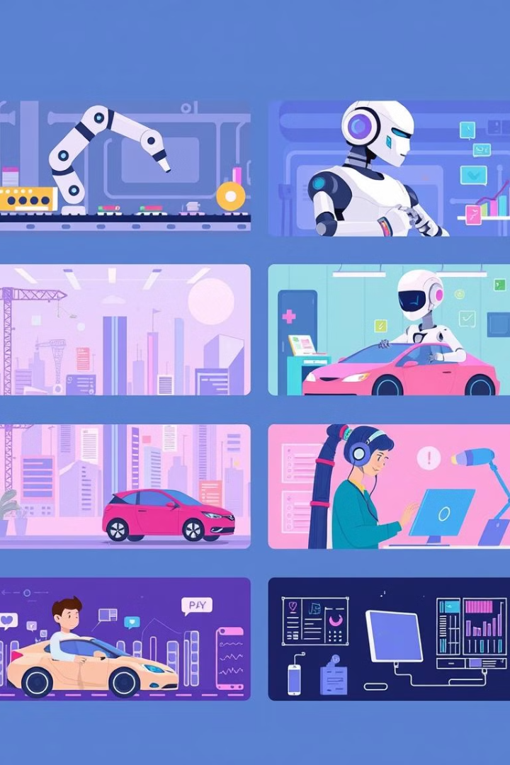
The Impact of AI and ML on Industry
20%
Increased Efficiency
AI and ML automate tasks, streamline processes, and optimize operations, boosting efficiency and productivity across various industries.
30%
Enhanced Customer Experiences
Personalized recommendations, intelligent chatbots, and AI-powered customer service provide tailored and seamless experiences.
50%
New Business Models
AI and ML enable innovative business models, fostering new products, services, and revenue streams.

Slide 10





Ethical Considerations in AI and ML
Bias and Fairness
AI systems can perpetuate biases present in training data, leading to unfair or discriminatory outcomes. It's crucial to ensure fairness and mitigate bias in AI algorithms.
Privacy and Security
AI systems often collect and process vast amounts of personal data, raising concerns about privacy and security. Strong safeguards are essential to protect user data.
Transparency and Explainability
AI decisions should be transparent and explainable, allowing users to understand the rationale behind them and fostering trust in the technology.
Accountability and Responsibility
Clear guidelines and mechanisms for accountability are needed to address potential harms caused by AI systems, ensuring responsible development and use.

Slide 11





The Future of AI and ML
AI-Powered Automation
1
AI will further automate tasks across industries, increasing efficiency and productivity.
2
Personalized Experiences
AI will personalize everything from healthcare to entertainment, tailoring experiences to individual needs.
3
Enhanced Human Capabilities
AI will augment human intelligence, improving decision-making, problem-solving, and creativity.
Solving Global Challenges
4
AI will play a key role in addressing global challenges like climate change, disease prevention, and sustainable development.
New Frontiers in Discovery
5
AI will drive breakthroughs in scientific research, leading to new discoveries and technological advancements.

Slide 12
Challenges and Limitations of AI and ML
1
Data Quality and Availability
Accurate and comprehensive data is crucial for training effective AI models. Limited or biased data can lead to inaccurate results and ethical concerns.
Model Interpretability and Explainability
2
Understanding how AI models make decisions can be challenging, particularly for complex models like deep neural networks. This lack of transparency can hinder trust and acceptance.
Computational Resources and Costs
3
Training and running advanced AI models often require significant computational power and resources, creating challenges for accessibility and affordability.
Generalization and Adaptation
4
AI models trained on specific datasets may struggle to generalize to new or unseen data, limiting their applicability in real-world scenarios.
Ethical Considerations
5
AI systems can raise ethical concerns regarding bias, privacy, security, and accountability, requiring careful consideration and responsible development.

Slide 13



Conclusion: A New Era of Innovation
Enhanced Human Capabilities
Solving Global Challenges
A Future of Endless Possibilities
AI and ML are not replacing humans but rather augmenting our capabilities, leading to a more efficient and productive future.
AI and ML can play a critical role in addressing pressing global issues, leading to a more sustainable and equitable world.
AI and ML hold the potential to transform every aspect of our lives, opening up new frontiers of innovation and progress.

